Slide 1
GRAIN PALETTE: A DEEP LEARNING ODYSSEY IN RICE TYPE CLASSIFICATION
BY-
N KARTHIK
N JAGADEESHWAR REDDY N VENKATESWARA REDDY NS IFFATH MUSKAN

Slide 2
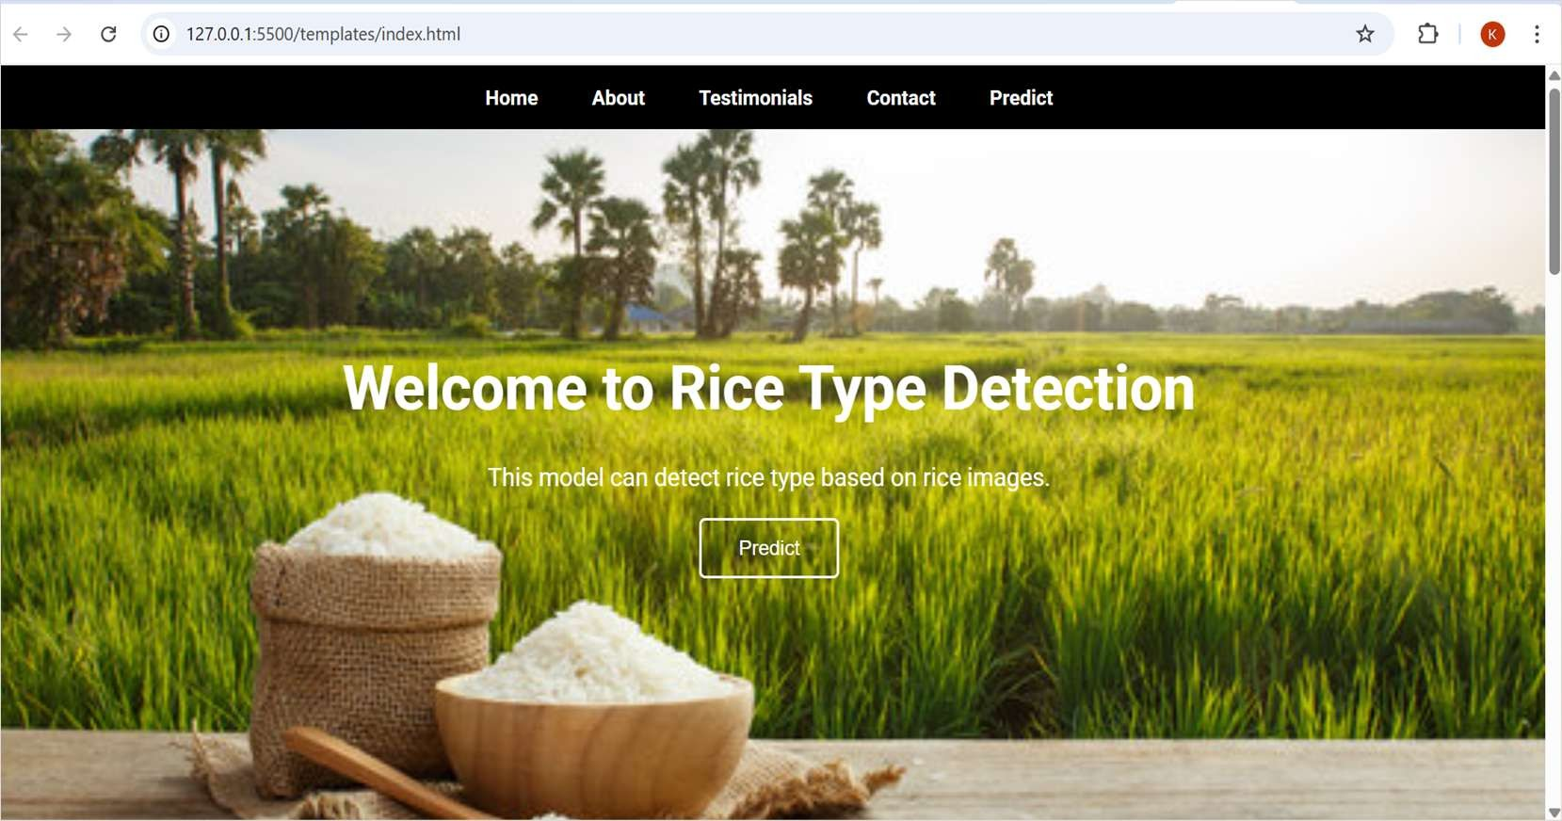
GRAIN PALETTE: A DEEP LEARNING ODYSSEY IN RICE TYPE
CLASSIFICATION
Using Transfer Learning

Slide 3
INTRODUCTION
• Manual rice-type sorting is slow and error-prone
• Need for automated, accurate classification system
Grain Palette aims to assist agricultural researchers and food industry professionals by providing a reliable, automated system for classifying different types of rice grains.

Slide 4
OBJECTIVES
•• Classify types of rice grains using deep learning
Identify ease of classification between rice types
Rice types: 1) Basmati
2)Jasmine 3)Arborio 4)Ipsala 5)Karacadag

Slide 5
DATASET
• Features extracted from rice grain images
• Classes: Jasmine (~55%) vs Gonen (~45%)
• Balanced dataset

Slide 6
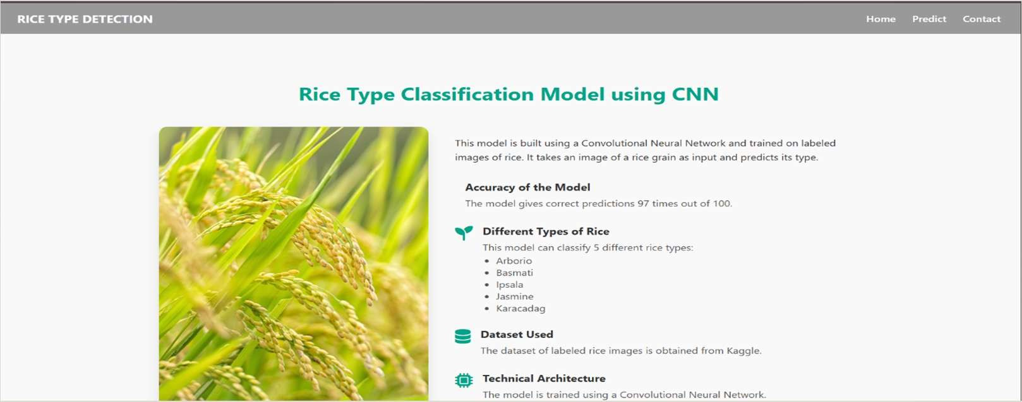
METHODOLOGY
• Preprocessing and feature extraction
• Transfer Learning using a pre-trained model (e.g.,VGG16)
• Custom classifier layers added

Slide 7
MODEL ARCHITECTURE
• Base: Pre-trained model (e.g.,VGG16, ResNet)
• Added dense layers with dropout
• Optimizer: Adam | Loss: Categorical Crossentropy

Slide 8
RESULTS
• Achieved accuracy: ~94%
• Metrics: Precision, Recall, F1-score
• Transfer Learning outperformed training from scratch

Slide 9
ANALYSIS
• Examined misclassifications
• Identified distinguishing features between classes
• Jasmine classified more accurately

Slide 10
CHALLENGES
• Limited dataset size
• Visual similarities among rice types
• Risk of overfitting without regularization

Slide 11
CONCLUSION & FUTURE WORK
• Transfer Learning enhanced performance
• Plan to expand dataset and rice types
• Potential for real-time classification app

Slide 12
REFERENCES
• GitHub repository: github.com/karthik8094/GrainPalette- A-Deep-Learning-Odyssey-In-Rice-Type-Classification- Through-Transfer-Learning
• Related research papers and datasets

